Slide 1
PHYS60022 Data Science and Machine Learning for Physics
Week 6: Discussion
Patrick Dunne, p.dunne12@imperial.ac.uk

Slide 2
What does good look like in a real analysis?

Slide 3
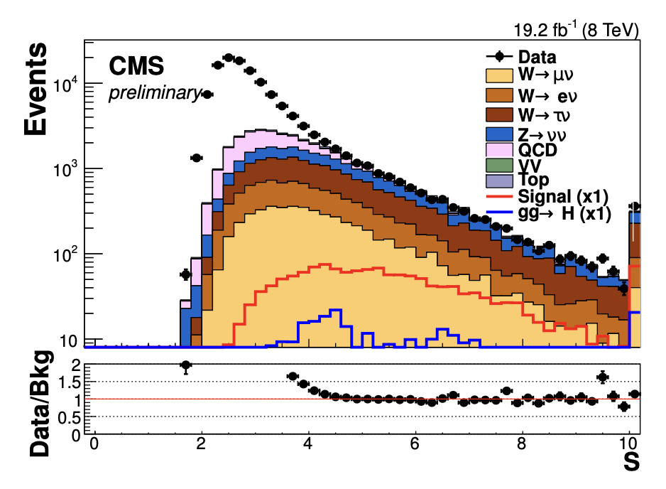
What does good look like in a real analysis?
This is a real analysis
Actually my PhD thesis
Stacked histogram is prediction from simulation
Black points are real data
Analysis optimisation is ‘cut based’ which is similar to choosing decision boundaries
Which of our metrics would work well in this case?
Maximising efficiency means you choose very mismodelled region
Maximising purity would cause you to throw away almost all the signal
Neither takes into account uncertainty on prediction

Slide 4
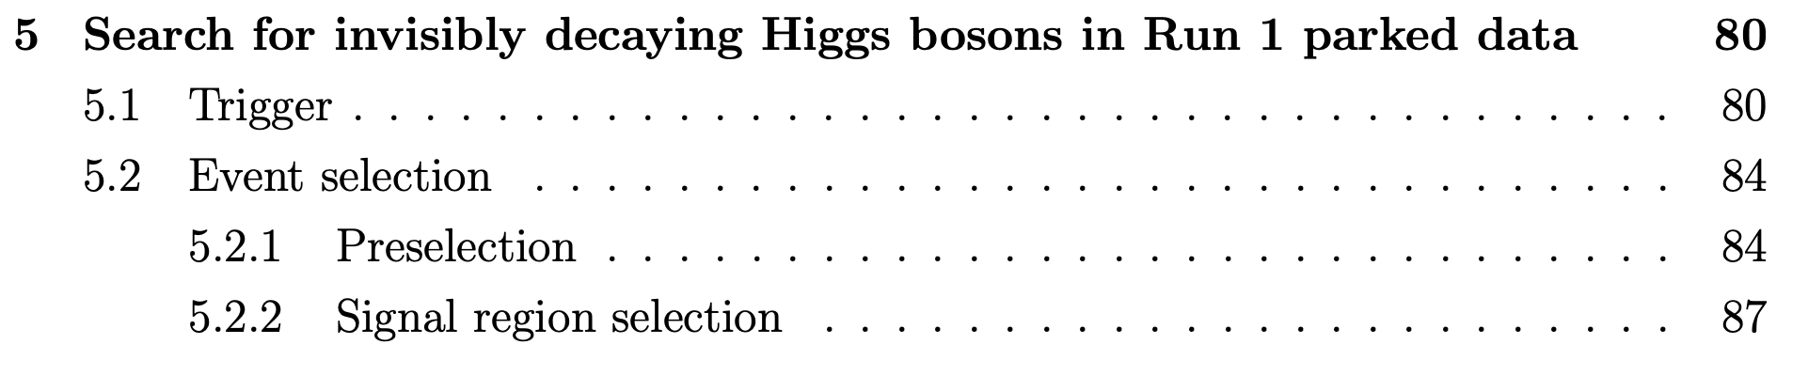
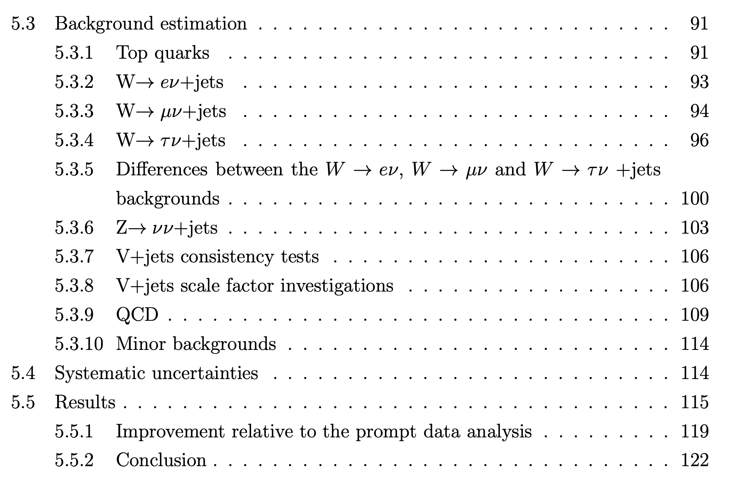
Real analysis has several steps each with different performance metrics
Continuing with thesis example
Decide which data to look at and find region where we think we can simulate it (plots from last slide)
Do that background modelling
Aiming here to minimise uncertainty on the background
Then you can properly optimise a signal region

Slide 5
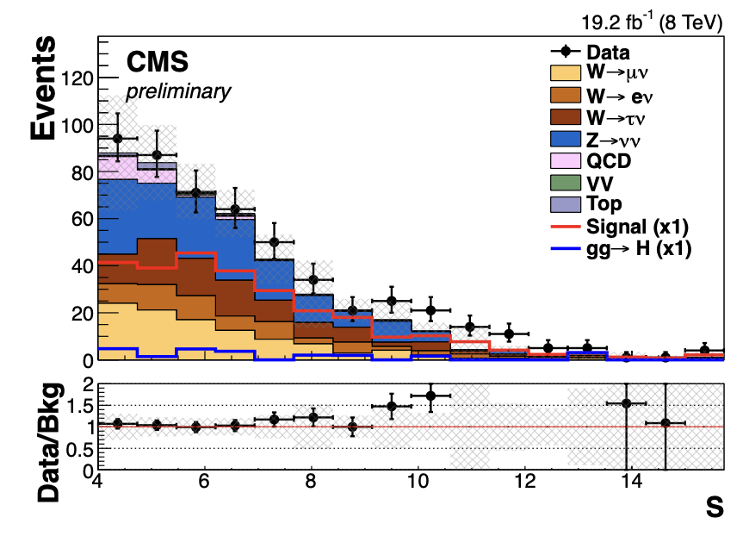
Final Result
Much better data/simulation agreement
Cut on this variable was 4
Several other cuts applied as well
Proper error estimation
What metric was used to optimise?

Slide 6
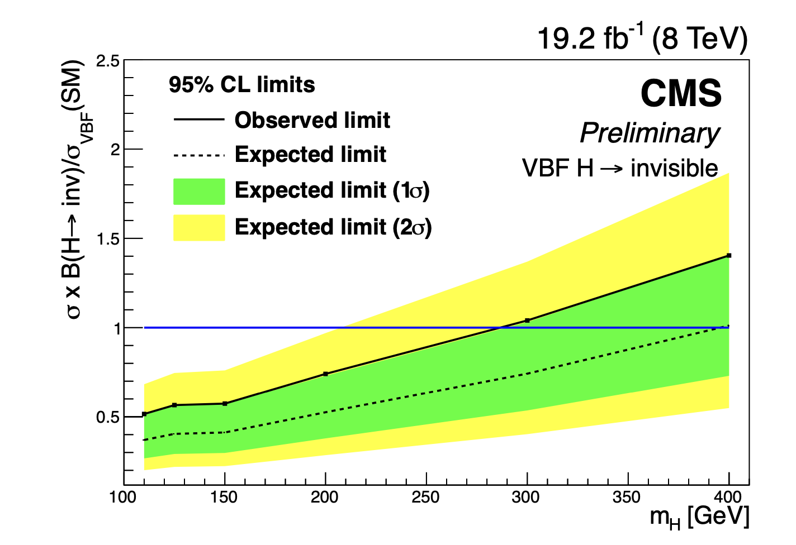
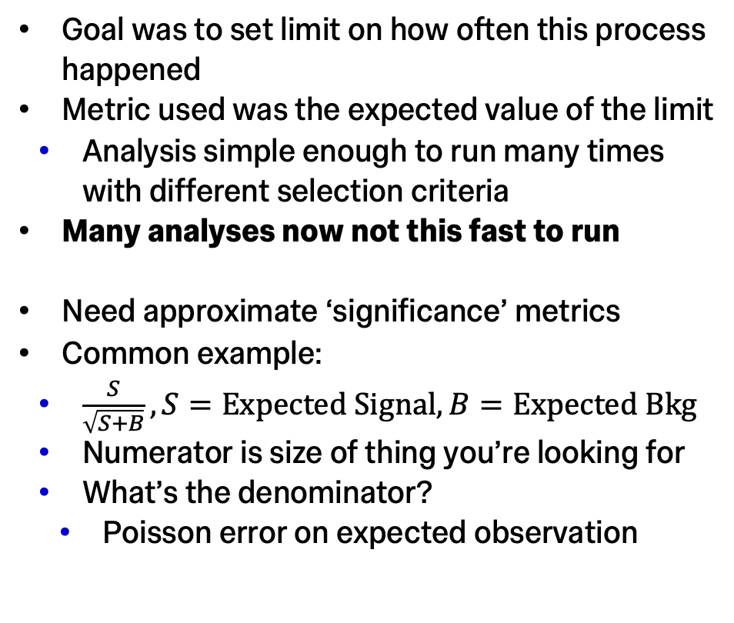
Metric should reflect your goal
Goal was to set limit on how often this process happened
Metric used was the expected value of the limit
Analysis simple enough to run many times with different selection criteria
Many analyses now not this fast to run
Need approximate ‘significance’ metrics
Common example:
$\frac{S}{\sqrt{S+B}}, S=Expected Signal, B=Expected Bkg$
Numerator is size of thing you’re looking for
What’s the denominator?
Poisson error on expected observation

Slide 7
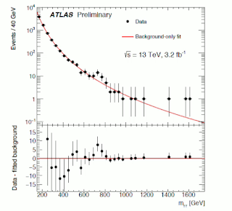
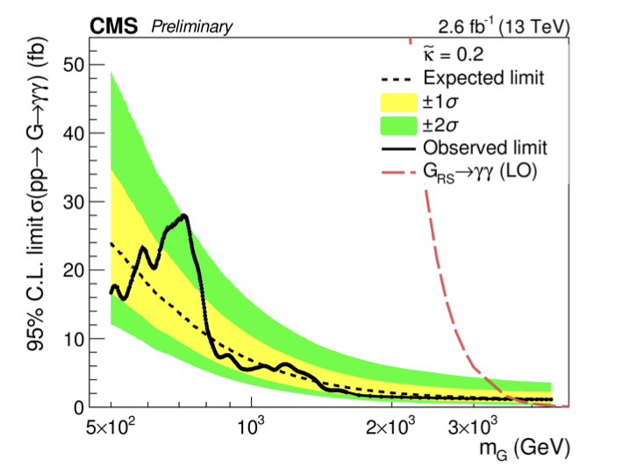
Blind Analysis
All optimisation after pre-selection did not look at data
Called ‘blind analysis’
Not done because of any technical difficulty looking at data
It is very hard as a scientist looking for an effect that could make or break your career not to get excited when you think you see a signal
Need to be sure it’s really there and not you tuning things to make it look bigger

Slide 8
Backup

Slide 9
Learning Outcomes
Learning outcomes for today
Introduce performance metrics used for classification
Familiarise you with ROC and ROC-AUC
Introduce performance metrics used for regression
Brief overview of data pre-processing
Introduce California housing and MNIST datasets used in exercises
You will use both kNN and SVM today
You don’t need to know the details of how SVM works just know how apply it and change its hyperparameters
Non-examinable SVM details are in the Bonus workbook on blackboard

Slide 10
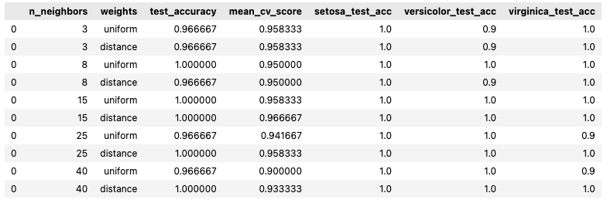
What problem are we trying to solve?
Goal of last week’s exercise was to classify irises as accurately as possible
But why?
Could be for an app for gardeners
Could be for customs control to stop an invasive species
Same problem in different contexts has very different criteria for success
Amateur gardeners probably happy with 90% accuracy
If border control misidentify 1 in 10 plants that’s a big problem

Slide 11
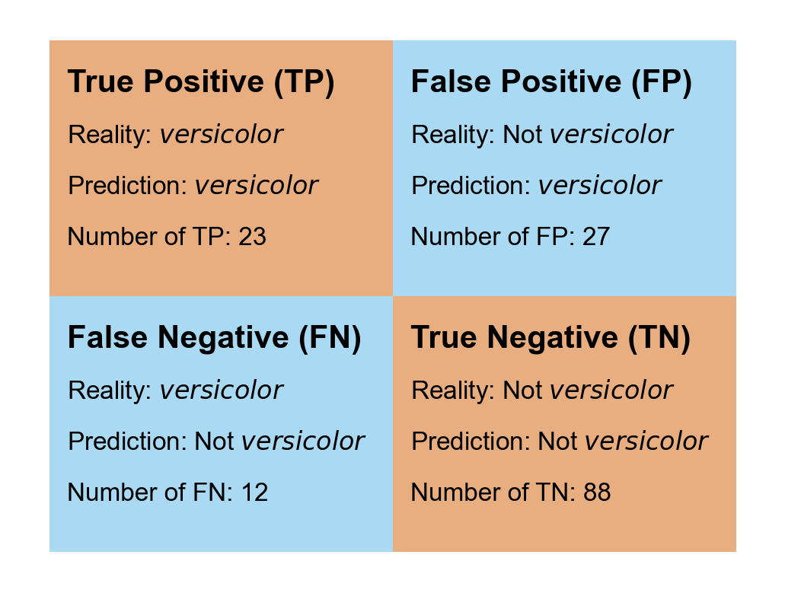
What are our types of error in classification?
Selected when it shouldn’t be:
False Positives
Type 1 Error
Not selected when it should have been:
False Negatives
Type 2 Error
Most common metrics take ratio of rate of these errors to a comparator population

Slide 12
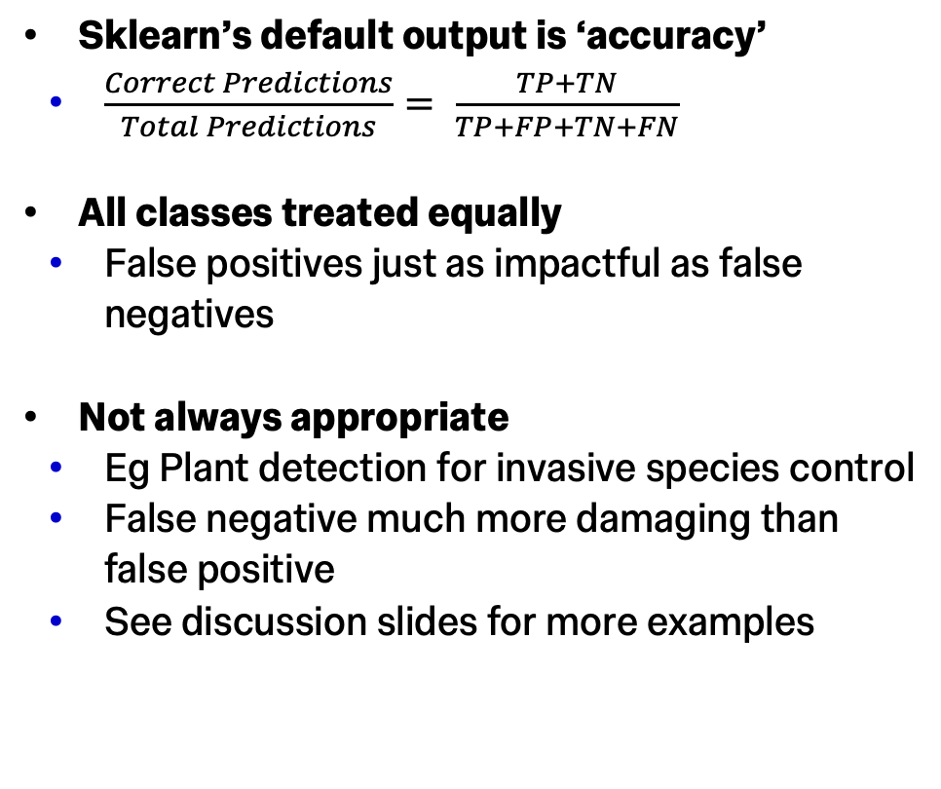
What metrics can we make with these errors?
Sklearn’s default output is ‘accuracy’
$\frac{Correct Predictions}{Total Predictions}= \frac{TP+TN}{TP+FP+TN+FN}$
All classes treated equally
False positives just as impactful as false negatives
Not always appropriate
Eg Plant detection for invasive species control
False negative much more damaging than false positive
See discussion slides for more examples

Slide 13
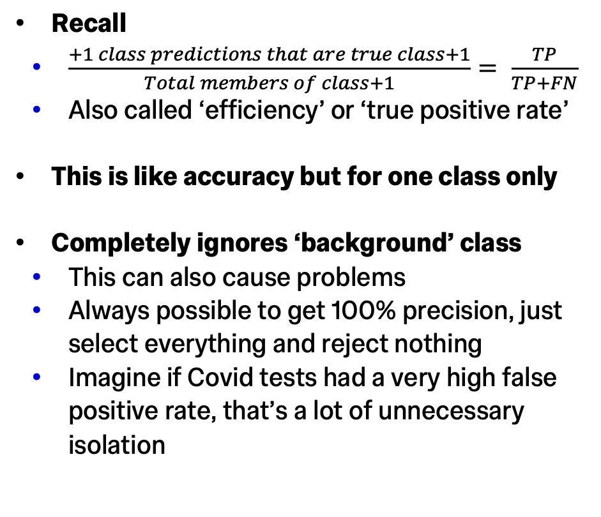
What metrics can we make with these errors?
Recall
$\frac{+1 class predictions that are true class+1}{Total members of class+1}= \frac{TP}{TP+FN}$
Also called ‘efficiency’ or ‘true positive rate’
This is like accuracy but for one class only
Completely ignores ‘background’ class
This can also cause problems
Always possible to get 100% precision, just select everything and reject nothing
Imagine if Covid tests had a very high false positive rate, that’s a lot of unnecessary isolation

Slide 14
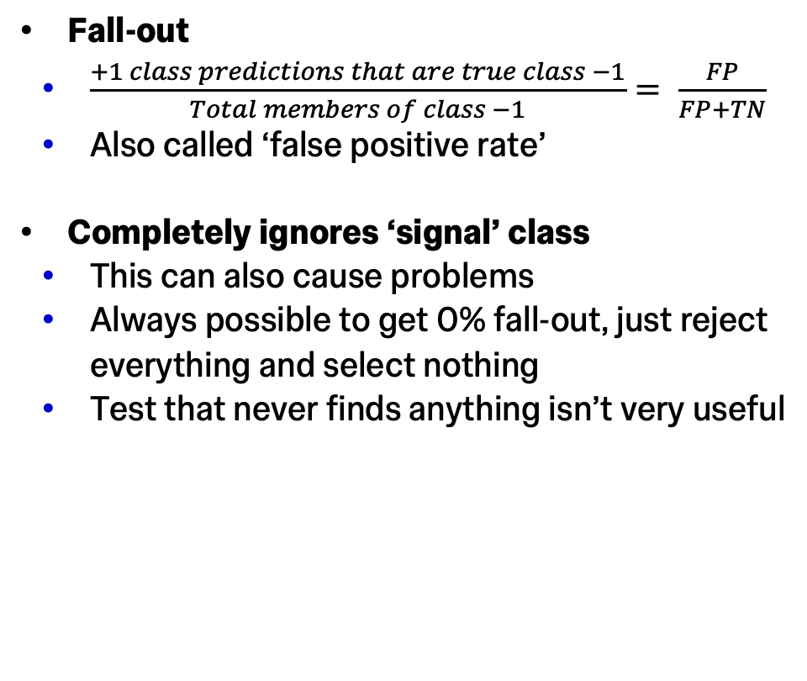
What metrics can we make with these errors?
Fall-out
$\frac{+1 class predictions that are true class −1}{Total members of class −1}= \frac{FP}{FP+TN}$
Also called ‘false positive rate’
Completely ignores ‘signal’ class
This can also cause problems
Always possible to get 0% fall-out, just reject everything and select nothing
Test that never finds anything isn’t very useful

Slide 15
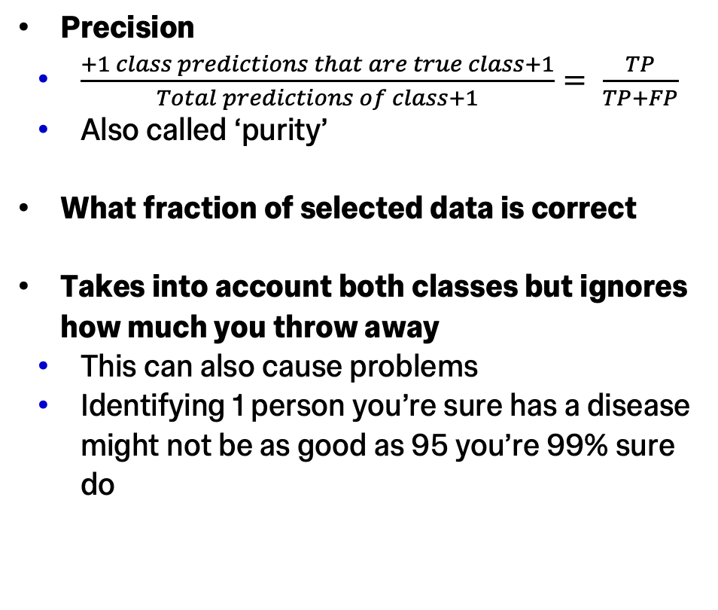
What metrics can we make with these errors?
Precision
$\frac{+1 class predictions that are true class+1}{Total predictions of class+1}= \frac{TP}{TP+FP}$
Also called ‘purity’
What fraction of selected data is correct
Takes into account both classes but ignores how much you throw away
This can also cause problems
Identifying 1 person you’re sure has a disease might not be as good as 95 you’re 99% sure do

Slide 16
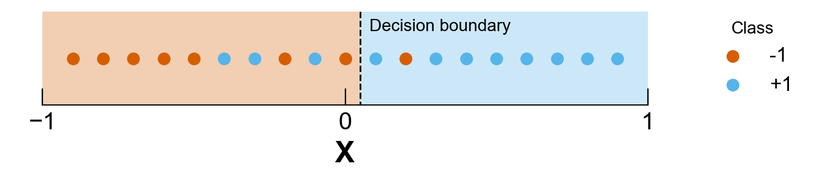
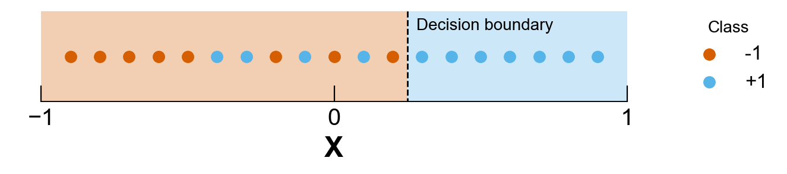
Maybe one number isn’t enough
Precision vs Recall
Classic tradeoff is ‘precision’ vs ‘recall’
AKA ‘purity’ vs ’efficiency’
Illustrate through choosing a decision boundary based on a score from a classifier
First case keeps 8/11 signal events but 1/9 of selected events are background
Second case keeps 7/11 signal events but 0/9 are background
Are you sure this will be 100% purity if you run it on a large sample of events?

Slide 17
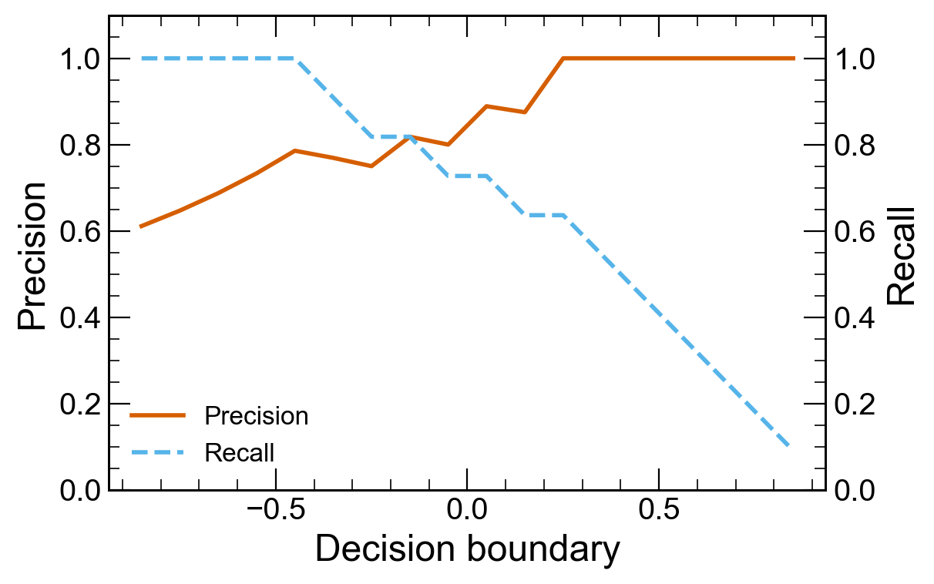
Maybe one number isn’t enough
Precision vs Recall
Classic tradeoff is ‘precision’ vs ‘recall’
AKA ‘purity’ vs ’efficiency’
Illustrate through choosing a decision boundary based on a score from a classifier
Common to plot precision and recall against boundary value
Also allows more sophisticated information like error on precision to be shown

Slide 18
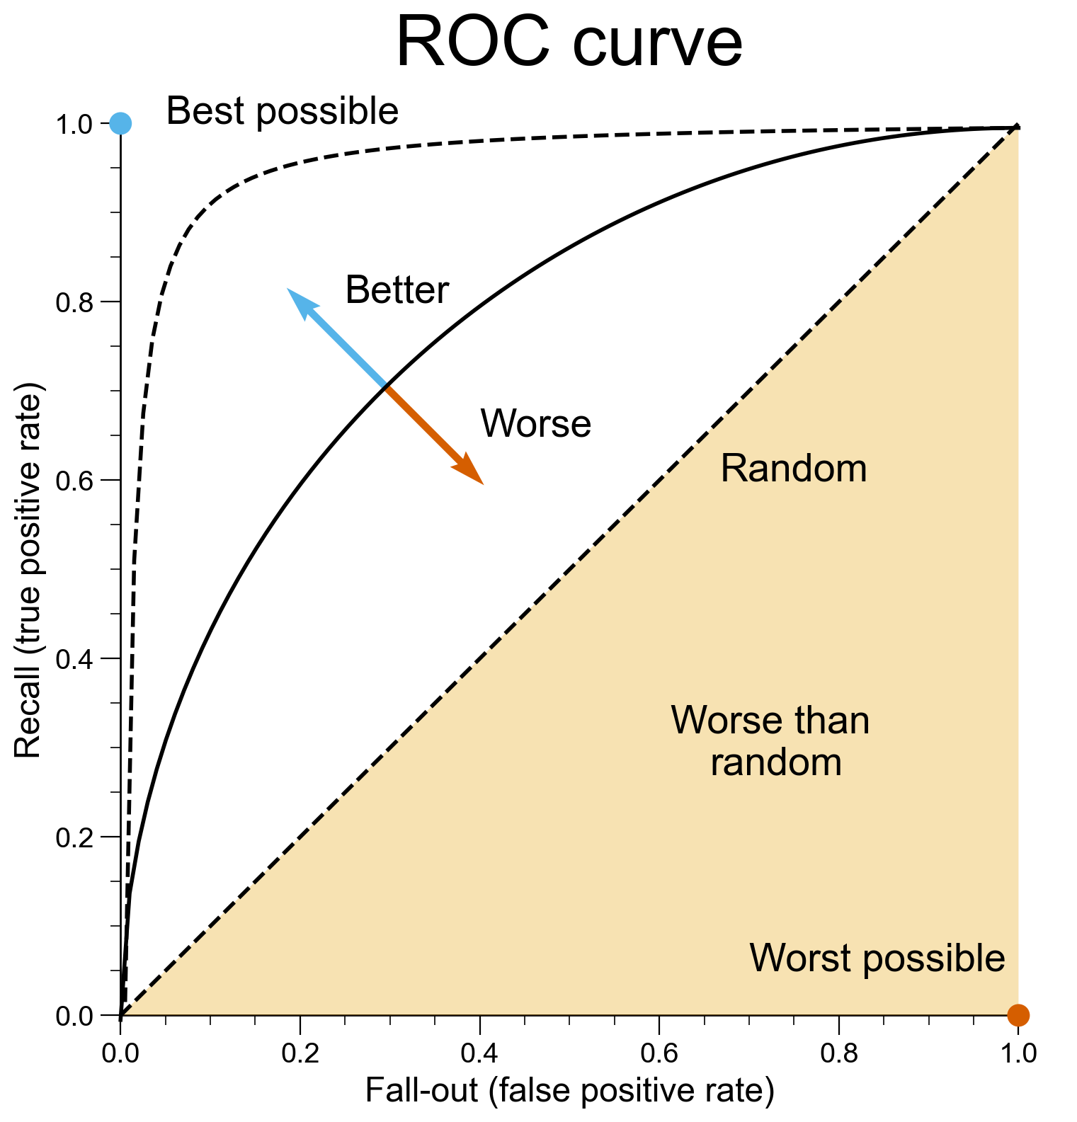
Maybe one number isn’t enough
ROC curve
Recall vs fall-out also very common
This is rate of Type 1 vs Type 2 errors
Called Receiver Operating Characteristic (ROC) Curve
Name comes from use during WWII for characterising radar receivers
Scan along the curve by changing decision boundary
All classifiers can reject everything or select everything so ends always in same place

Slide 19
Maybe one number is enough
AUC
Useful to be able to judge different classifiers quantitatively against each other
Can summarise ROC curve by taking Area Under Curve (AUC)
Perfect classifier has AUC of 1
Random classifier has AUC of 0.5
Worst possible classifier has AUC 0
You still have to choose a boundary later but can be useful for automatic scanning over many classifiers

Slide 20
What does good look like?
Regression

Slide 21
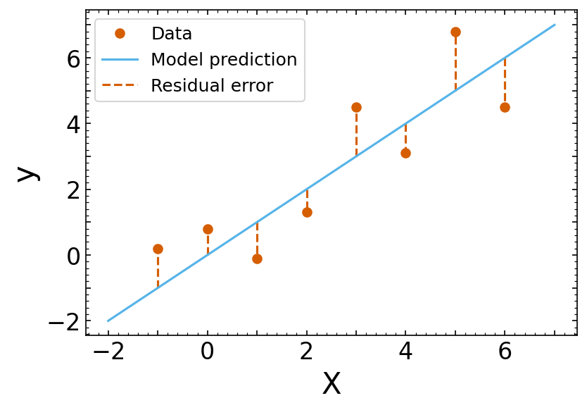
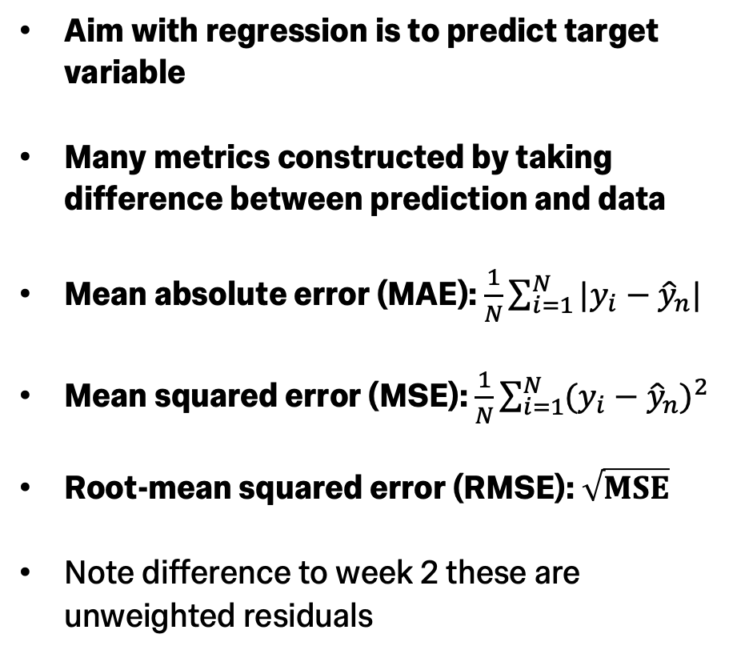
Residual based methods
Aim with regression is to predict target variable
Many metrics constructed by taking difference between prediction and data
Mean absolute error (MAE): $\frac{1}{N}\sum_{i=1}^{N}{|y_{i}−{\hat{y}}_{n}|}$
Mean squared error (MSE): $\frac{1}{N}\sum_{i=1}^{N}{(y_{i}−{\hat{y}}_{n})^{2}}$
Root-mean squared error (RMSE): $\sqrt{MSE}$
Note difference to week 2 these are unweighted residuals

Slide 22
Residual based methods
Which to choose?
Best depends on context!
Do metric and data need to have same units:
MAE or RMSE do
Is the metric differentiable:
MSE and RMSE are
Very important for any gradient descent based optimisation
Is the metric robust against outliers:
MSE and RMSE square the residual so give strong penalties to outliers
MAE gives less strong penalty

Slide 23
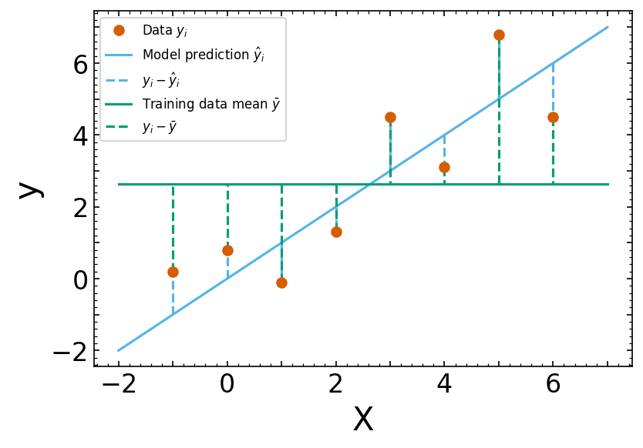
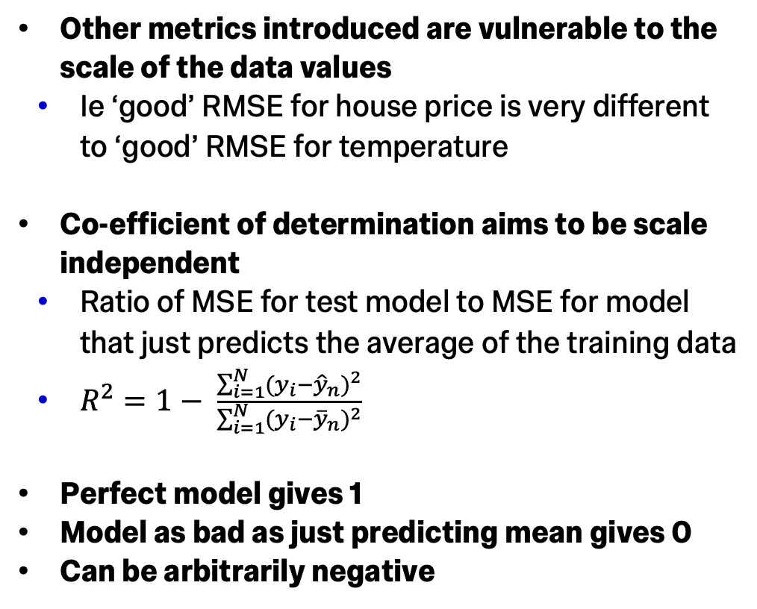
Coefficient of determination R²
Other metrics introduced are vulnerable to the scale of the data values
Ie ‘good’ RMSE for house price is very different to ‘good’ RMSE for temperature
Co-efficient of determination aims to be scale independent
Ratio of MSE for test model to MSE for model that just predicts the average of the training data
$R^{2}=1− \frac{\sum_{i=1}^{N}{(y_{i}−{\hat{y}}_{n})^{2}}}{\sum_{i=1}^{N}{(y_{i}−{\overline{y}}_{n})^{2}}}$
Perfect model gives 1
Model as bad as just predicting mean gives 0
Can be arbitrarily negative

Slide 24
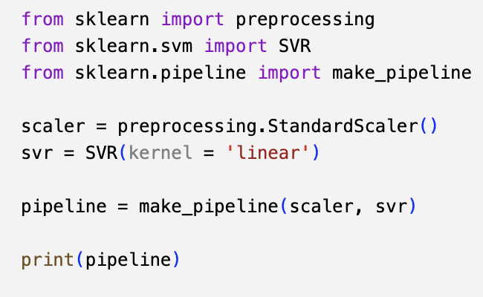
Aside on pre-processing
Not just performance metrics where issues like input data scale can be important
Relative feature importance also hard for algorithm to judge with differing feature scale
Why not rescale all features so they have the same scale?
Common to scale minimum to 0, maximum to 1
Sometimes scale to make RMSE 1
Other common pre-processing:
Encoding non-numeric data:
Eg does house have garden, cat vs dog vs bird
Discretisation
Eg ’binning’ continuous variable into categories

Slide 25
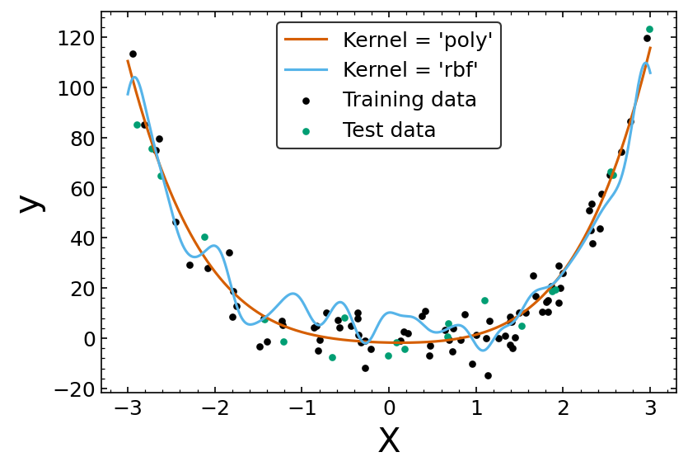
Goodness of fit
Wait didn’t Nick teach me some stats?
Regression models give you distributions of predicted value
Can construct cumulative distribution function
Kolmogorov-Smirnov test between training data and regression model can be used as a metric
Example shown is polynomial data:
SVM with ‘poly’ kernel gives KS p-value: 98.3%
SVM with ‘rbf’ kernel gives KS p-value: 17.5%

Slide 26
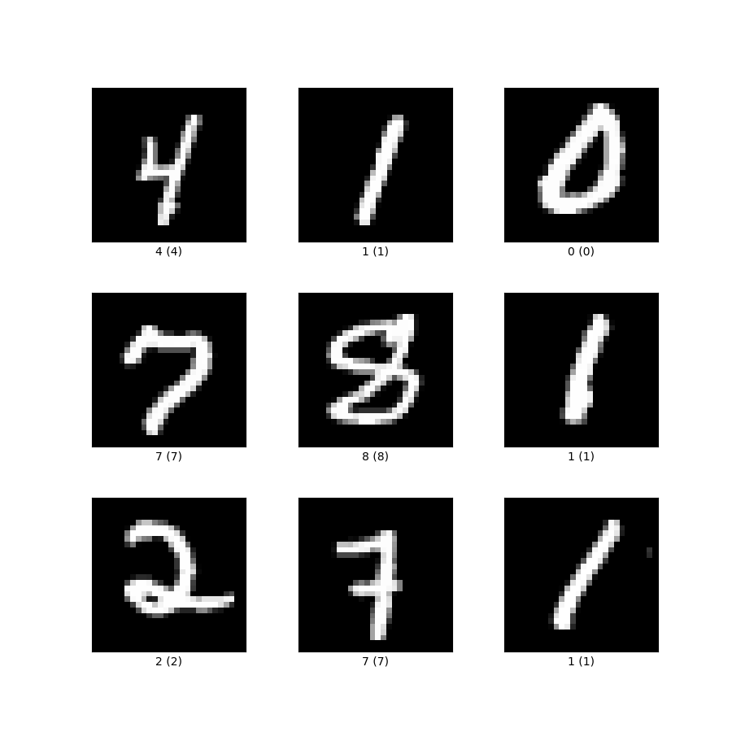
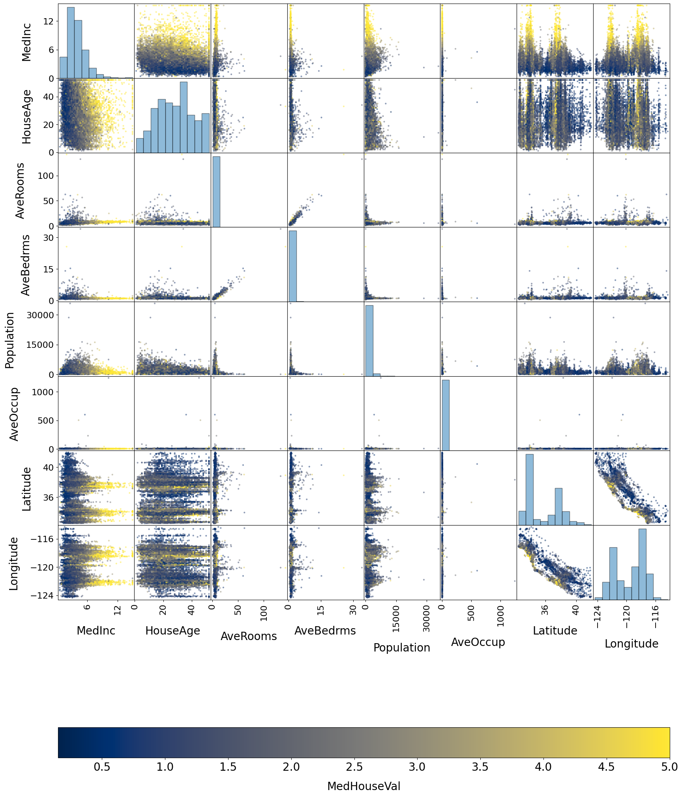
Datasets for today’s exercises
MNIST (Classification)
Images of grainy numbers
California housing (Regression)
House price vs eg number of rooms etc.

Slide 27
Exercises!

Slide 28
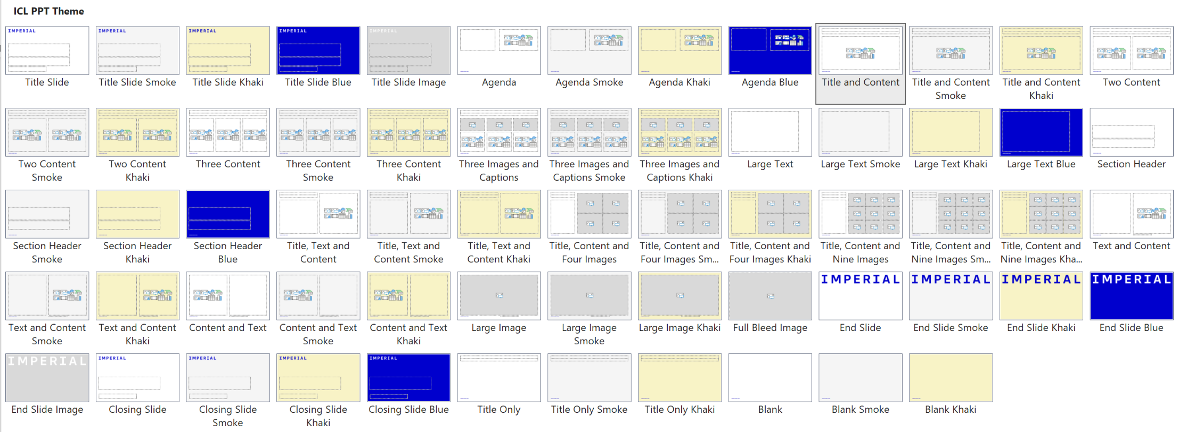
Notes to the template
Custom layouts and example slides
The template includes a range of predefined layouts that you can insert. These have been designed to cater for text, text and images and for picture arrangements. There are also layouts for Title and Divider slides.
Each custom layout includes the correct colour palette, type levels and formatting.
You can choose one of the layouts using the ‘New Slide’ button on the Home tab. You can also change the layout for a current slide using the ‘Layout’ list on the Home tab.

Slide 29
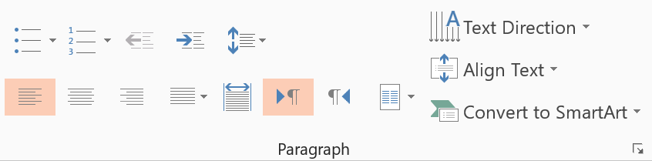
Notes to the template
Type levels and bullets
The standard text area has five predefined type levels.
You can move up or down the levels using the increase or decrease indent buttons in the home tab.
We recommend that you do not use the bullet button, as this does not apply the correct bullet formatting.
Level one is for general text
Level two is for subheadings within body copy
Level three is the first level of bullets
Level four is the second level of bullets
Level five is the third level of bullets
While text boxes are formatted to be the correct font, size, and colour, they will not contain the levels as a placeholder does. Therefore, it is recommended that you copy an existing text placeholder on the slide if you would like to insert a text box, to preserve the use of these levels.
Decrease list level
Increase list level

Slide 30
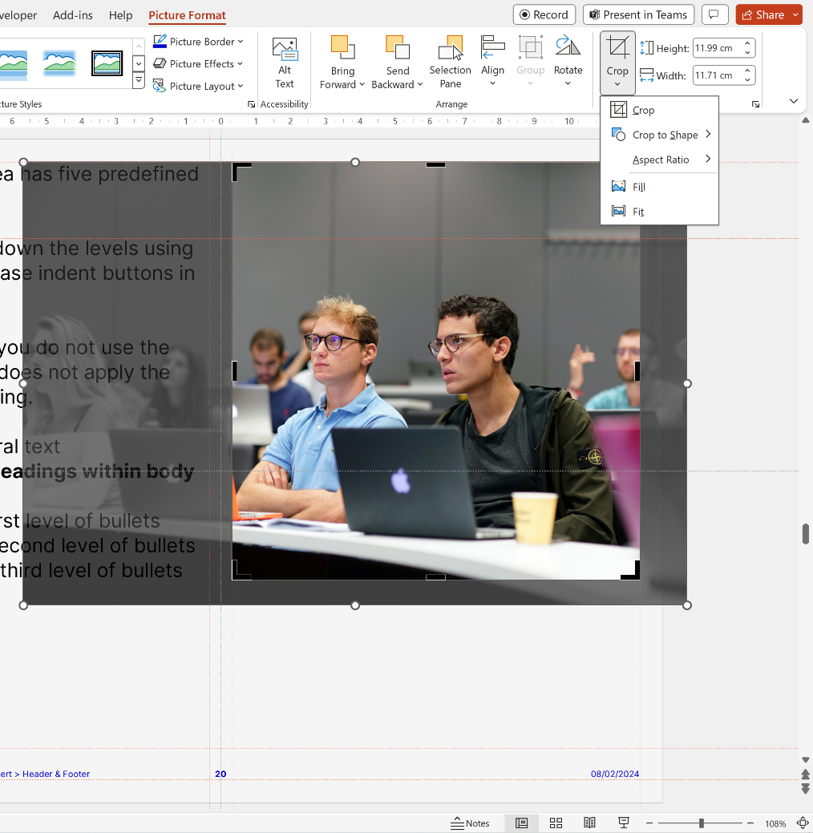
Notes to the template
Using picture slide layouts
The picture slides are predefined with picture placeholders that help you to manage the image you add into the field.
Click the button in the middle of the field to select and import the picture you want to use. The picture field will automatically fill the field with the image.
You can edit the position of the image using the crop tool, which is in the ‘Picture Tools > Format menu. This menu appears when you click on an image.
The crop tool allows you to enlarge, adjust position or crop the image to fit.

Slide 31
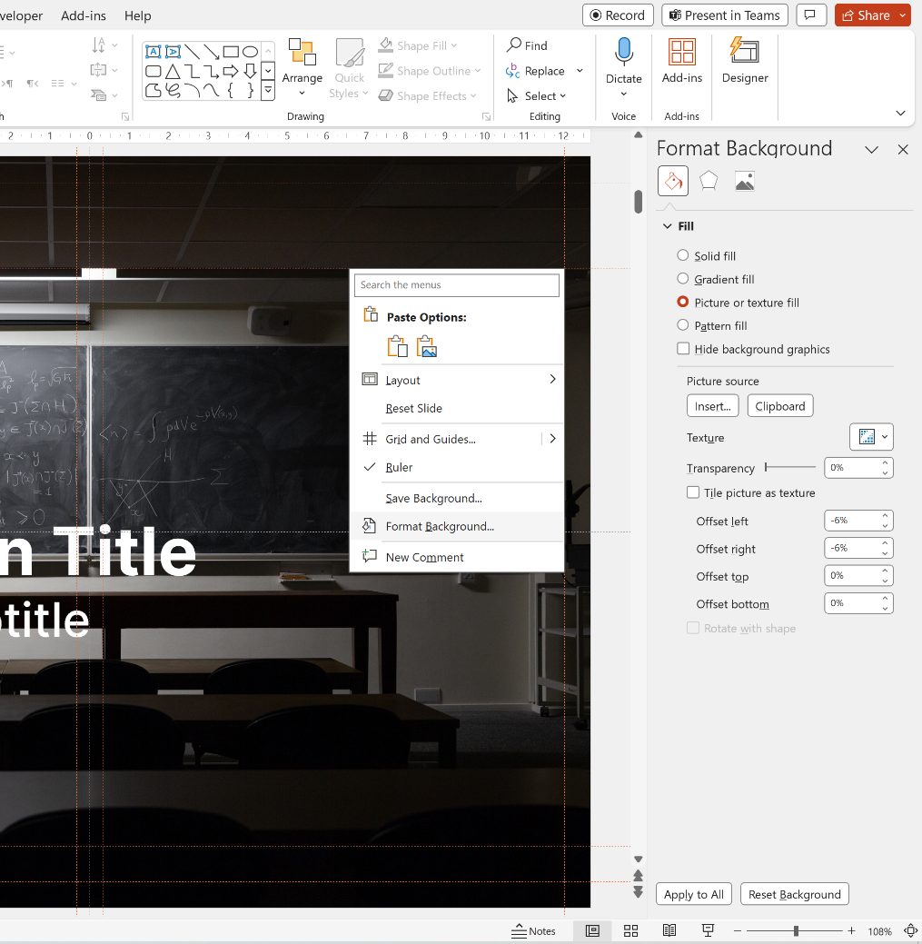
Notes to the template
Applying images to backgrounds
If you insert a Title or End Slide Image layout, you will find that the background is filled with a solid grey. This means that you can insert your own image to the background.
The first step is to right-click the background and choose Format Background – this will open a panel on the right of the screen.
Then, tick the Picture or texture fill box, and choose Insert Picture from File. Select an image from your computer, ensuring it follows brand guidelines, and the picture will automatically fill the background of the slide.

Slide 32
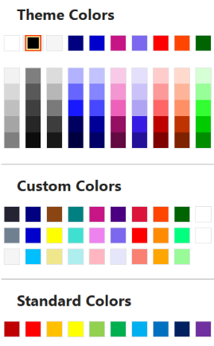
Notes to the template
Tips and recommendations
Type levels
Always use the type levels in the predefined content placeholders, supplied with each layout.
Text boxes
If you use text boxes, please note that they do not include the type levels. Any formatting has to be manually applied, and we recommend you adhere to the brand rules.
Footers
The footer and page number can be modified and turned on or off. To do this, go to the Insert tab on the ribbon, then click Header and Footer.
Colour palette
Always select a colour from the supplied colours.
The top row represents the correct brand colours and are automatically used in charts and diagrams.
The Custom Colors section contains all of the brand colours, some in multiple tints. Please use these as required.
The Standard Colors row is supplied by Office and does not follow brand guidelines. Please do not use these colours in your documents.

Slide 33
Thank you
Presentation Title
DD/MM/YYYY

